Slide 1
The Fate of the Housing Loan
A hack presented by:
Shivangi Gupta
Kaveesha Shah
Monica Kanasani
Manvitha Vajrala

Slide 2
Problem Statement
Analyze and visualize data to study the effect of various risk factors involved in predicting the status of the loan.
Develop a classification model to predict the category of loan status.

Slide 3
Data and Tech Stack
Data sourced from :
https://loanperformancedata.fanniemae.com/lppub/index.html#Portfolio
2 tables:
Acquisition: Fannie Mae acquisitions between January 1, 2000 and March 31, 2012
Performance: corresponding monthly performance data as of December 31, 2012.

Slide 4
Approach
Study the data to understand the type of factors involved in the data sets.
Correlation matrix is plotted to determine the relationship between the variables.
Interesting finds:
Higher the interest rate, higher will be the risk of bank recovering the loan.
The increase in change in interest rateis found out to b inversely proportional to the risk factor.

Slide 5
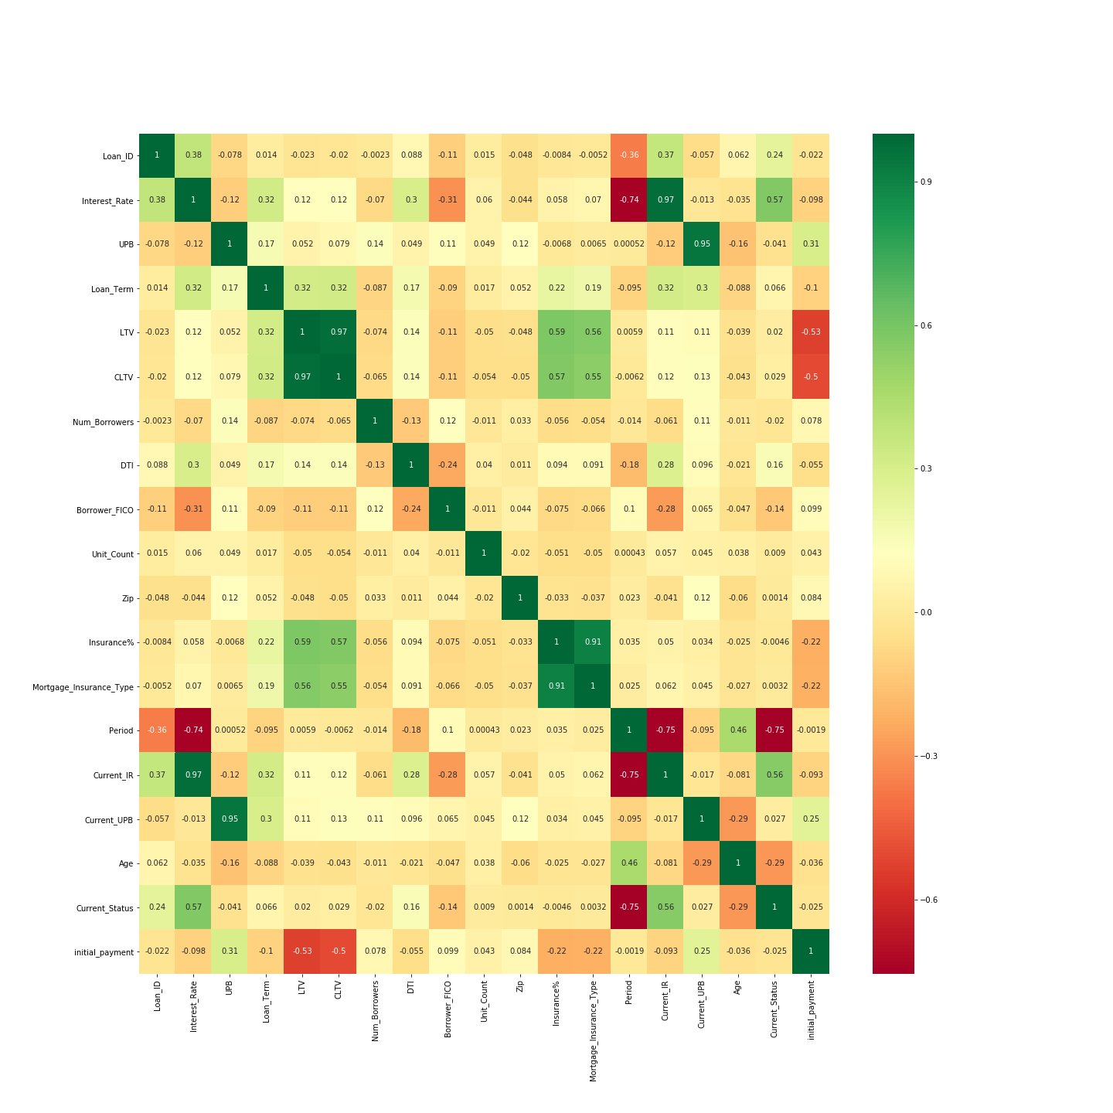
Correlation matrix

Slide 6
Interesting finds:
Higher the interest rate, higher will be the risk of bank recovering the loan.
The increase in change in interest rates found out to be inversely proportional to the risk factor.
Change in Mod Index states shows the difference in interest rates which in turn relates to risk

Slide 7
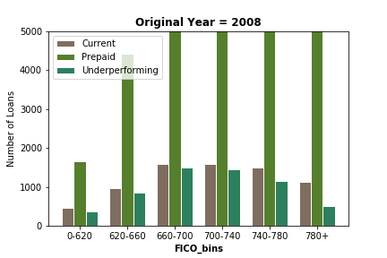
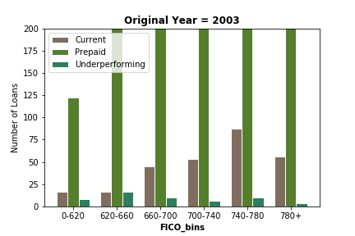
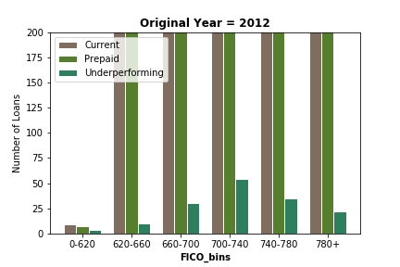
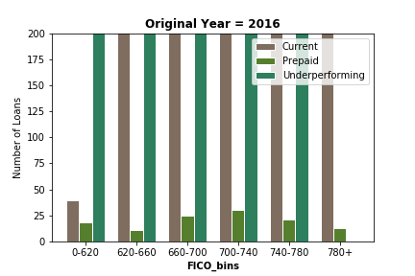
Bar graph for credit score vs loan status for 4 years.

Slide 8
Bar graph for credit score vs loan status for 4 years.
Over the 4 taken years, there were more number of prepaid loans in 2003,08,12.
Current Loans are more present in 2012 and 16.
Also, the credit score played a role in determining the payoff of the loan.
Higher the credit score, lower the underperforming loans.

Slide 9
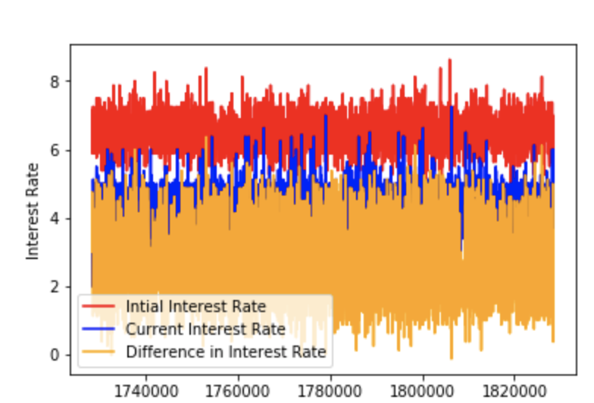
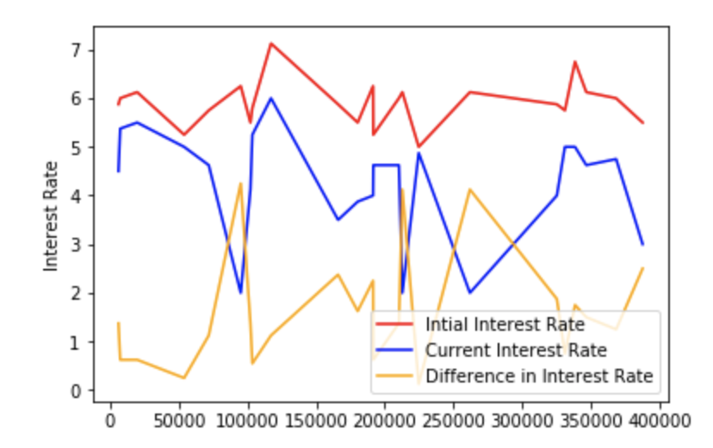
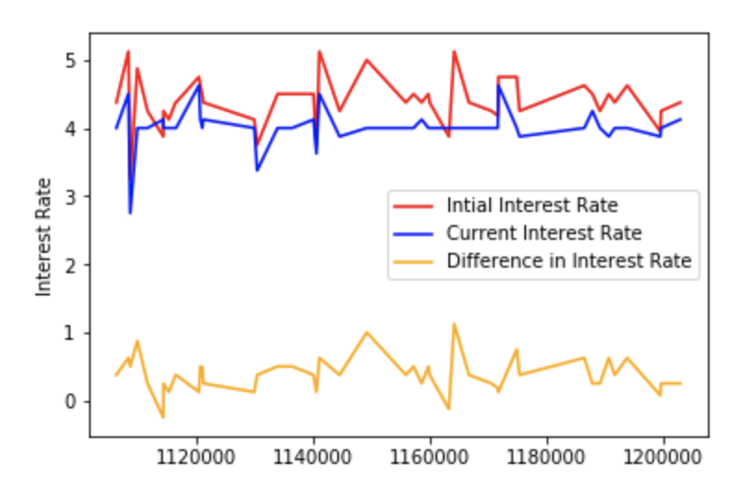
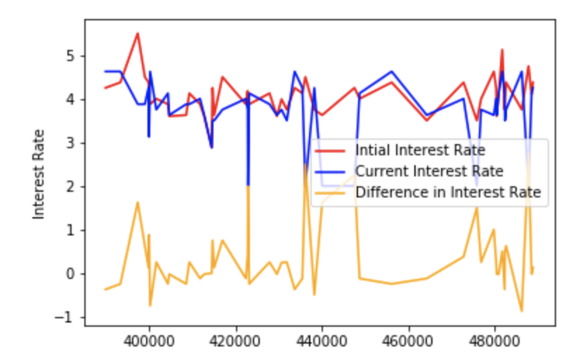
Interest rate analysis for 4 years
2003
2008
2012
2016

Slide 10
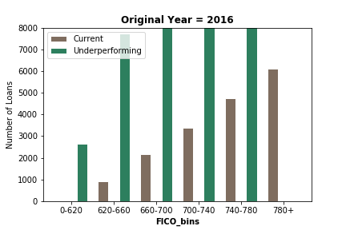
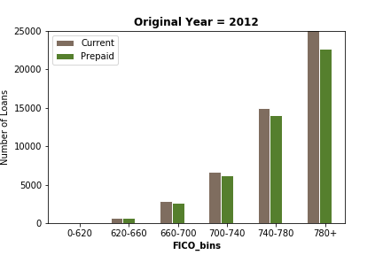

Slide 11
Feature used for model
Interest_Rate
UPB
Loan_Term
LTV
Num_Borrowers
Borrower_FICO
DTI
Insurance%
Period
Current_Status
Current_UPB

Slide 12
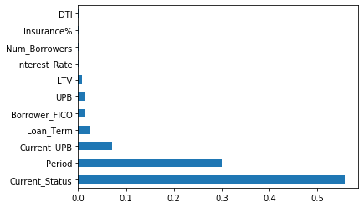
Importance of Features
Important features are selected using the random forest and used for the prediction model to reduce the redundancy.

Slide 13
Model Creation
Experimented with 3 classification models:
Random Forest
Accuracy for Random Forest on test data: 98.83%
XgBoost
Accuracy for XgBoost on test data: 99%
Logistic Regression
Prediction model is developed.

